Slide 1
Question 1: The type of computer, which has the properties of both i.e. analogue computer and digital computer, is known as _________
A) Analogue-cum Digital Computer
B) Super Computer
C) Hybrid Computer
D) Computer of Future

Slide 2
Question 2: Which of the following is not an operating system?
A) Windows
B) Linux
C) Oracle
D) macOS

Slide 3
Question 3: A sort of malware computer program that keeps replicating itself and can easily get diffused into other computers through internet is known as _____
A) Virus
B) Worms
C) Trojans
D) Spyware

Slide 4
Question 4: Which among the following period is known as the era of second generation computer?
A) 1971 to 1980
B) 1976 to 1985
C) 1990 to 2000
D) 1982 onwards

Slide 5
Question 5: Who among the following has designed the Java programing language?
A) Rasmus Lerdorf
B) Guido van Rossum
C) Brendan Eich
D) James Gosling

Slide 6
Question 6: Which among the following is known as point-and-draw device?
A) Keyboard
B) Scanner
C) Mouse
D) CPU

Slide 7
Question 7: Node is a connection or junction point in a computer networking system.
A) False
B) True

Slide 8
Question 8: Which among the following was the first computer virus?
A) Conifer
B) I Love you
C) Melissa
D) Elk

Slide 9
Question 9: Which device is used to connect to the internet?
A) Flash
B) Scanner
C) Router
D) Printer

Slide 10
Question 10: The software, which can be used on an installed operating system, is known as ________
A) Internet
B) Application Software
C) Operating System
D) All of the above

Slide 11
Question 11: An example of programming language that interact directly with processor is known as ______
A) High Level Language
B) Assembly Language
C) Programming Lanhuage
D) System Software

Slide 12
Question 12: Which of the following might be done offline?
A) Passport Application
B) E-commerce Transactions
C) Instant Messaging
D) Video Conferencing

Slide 13
Question 13: This technique provides facility to store and execute more than one program in the Central Processing Unit (CPU) simultaneously?
A) Real Time Processing
B) Multiple Processing
C) Time Sharing Processing
D) Many to Many Processing

Slide 14
Question 14: _____ is a blueprint that pictorially represents the algorithm and its steps?
A) Algorithm
B) System Diagram
C) Flowchart
D) Data Analysis

Slide 15
Question 15: ___ is a private network organization, which is actually the part of respective company’s intranet and its services are extended to users outside the company?
A) Internet
B) Extranet
C) Intranet
D) Networking

Slide 16
Question 16: ___ is computer system has high capacity to integrate different media including text, image, graphics, audio, and video?
A) Computer
B) Software Packages
C) Multimedia
D) Computer System

Slide 17
Question 17: The programs machine instructions are store in __ memory segment.
A) Data
B) Stack
C) Heap
D) Code

Slide 18
Question 18: ___ is a proper technique that illustrates the right solution in logical and feasible steps?
A) Data
B) Coding
C) Algorithm
D) Graph

Slide 19
Question 19: ___ is depending upon the power of the computer, it can perform, it can take Millions of instructions per second.
A) Diligence
B) Memory
C) Storage
D) Speed

Slide 20
Question 20: In 1822, who developed a machine capable to calculate the successive difference of expression and prepared a table which helped him in his calculations.
A) Lady Ada Lovelace
B) Charles Babbage
C) Blaise Pascal
D) John Napier

Slide 21
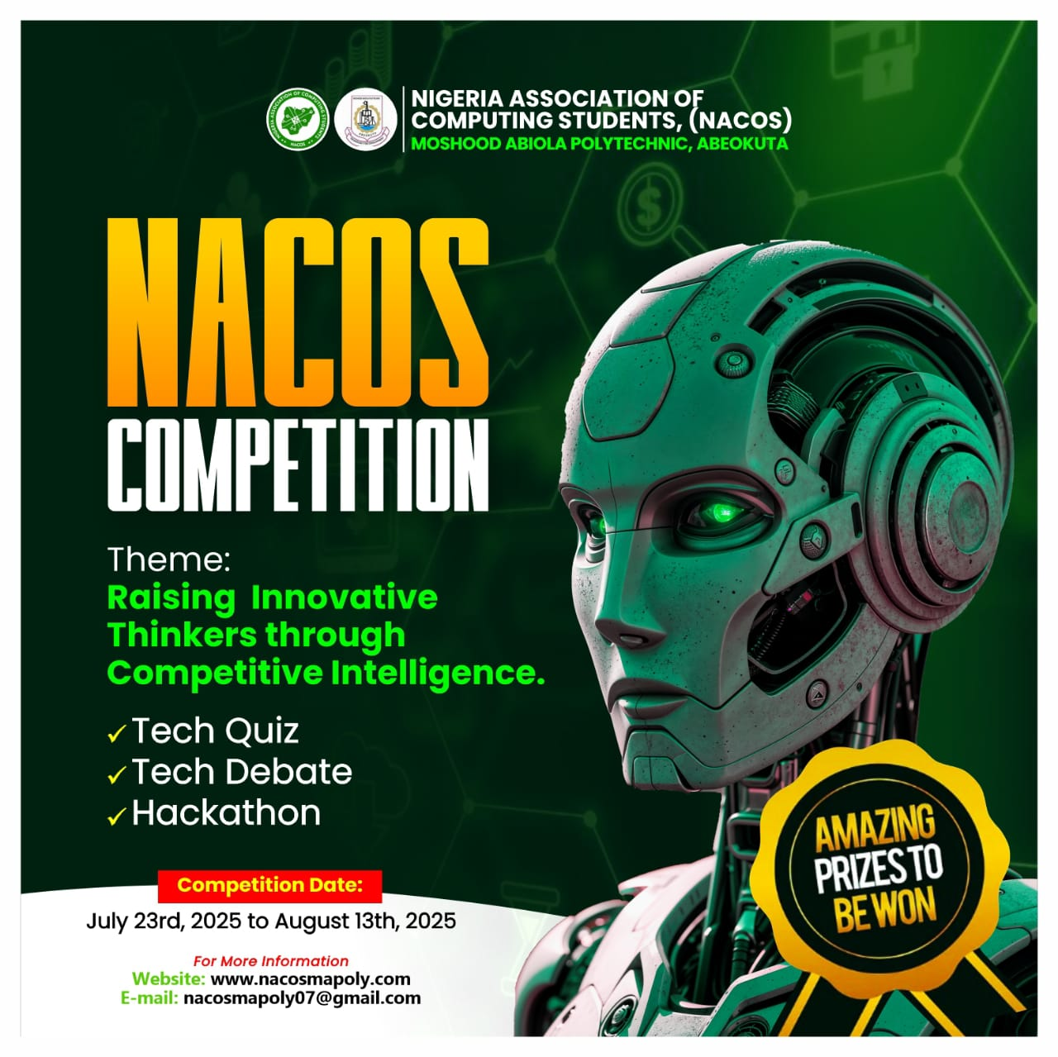
END OF THE FIRST SESSION

